Slide 1
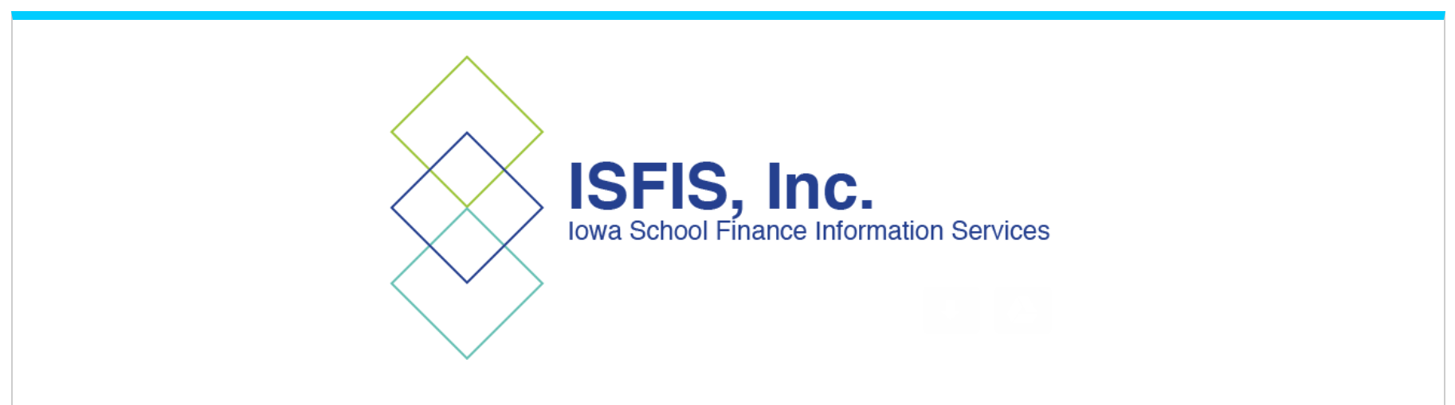
April 2022
ISFIS Special Topic Webinar
Five Things You Probably Don’t Know About Equipment Maintenance Insurance
© Iowa School Finance Information Services, 2022

Slide 2
SitRep Resources
PPT is linked on the ISFIS webinar webpage
Use the slides and information as you see fit
OK to share with others in your district
Let us know if others in your district need an invite to attend the webinars
If you are not an ISFIS Subscriber and interested in learning more, contact jen@iowaschoolfinance.com

Slide 3
Connect with ISFIS
Are you connected with ISFIS on Social Media?
Follow us on Twitter: @ISFISInc
Like us on Facebook: https://www.facebook.com/isfisinc/
Link to us on LinkedIn: https://www.linkedin.com/company/iowa-school-finance-information-services
If you or anyone at your district needs access to the ISFIS subscriber content on the website, email jen@iowaschoolfinance.com
Please check with others at your district to make sure they’re getting our emails & invites!

Slide 4
What is the Equipment Maintenance Program?

Slide 5
What is an Equipment Maintenance Insurance Policy?
An insurance policy that pays benefits (claims) for repairing or replacing damaged or broken-down electrical or electronic equipment after a covered incident.
Commercial Property Policies generally cover damage caused by external forces (such as fire or tornado) but generally wouldn’t cover damaged caused by internal forces (such as accidental breakage, mechanical breakdowns, or operator error).

Slide 6
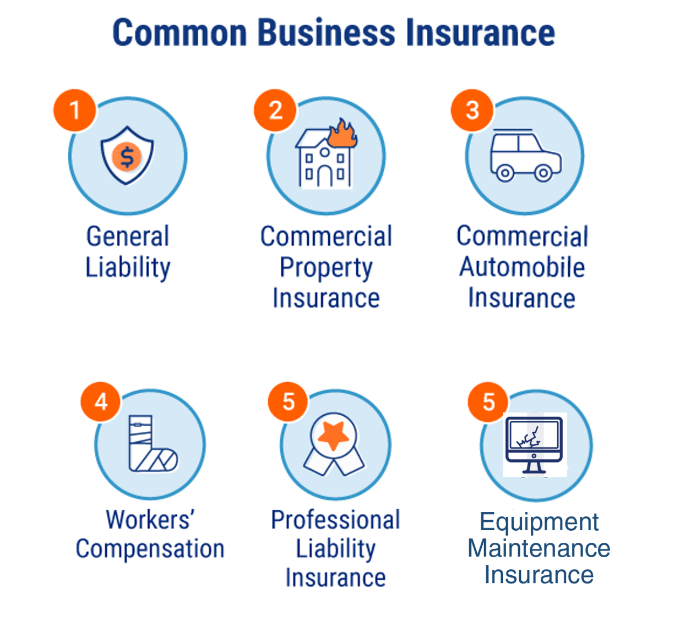
What is an Equipment Maintenance Insurance Policy?

Slide 7
What is an Equipment Maintenance Insurance Policy?
Jester and Specialty Underwriters created this program in 1999 specifically for Iowa K-12 schools. Celebrating our 22nd year.
These types of policies have been around for decades to help people and businesses manage risk. Similar to home warranty or extended warranty maintenance plans.

Slide 8
What is an Equipment Maintenance Insurance Policy?
ISFIS has sponsored the Equipment Maintenance Program offered by Jester Insurance and Specialty Underwriters since ISFIS was first formed.
Jester Insurance works with more than 95% of Iowa public schools on property & casualty insurance (EMC Safety Group), and developed a long-term partner in Specialty Underwriters for their Equipment Maintenance Insurance Program

Slide 9
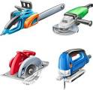
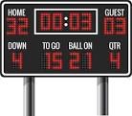
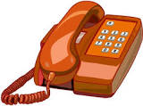
What does the Equipment Maintenance Insurance cover?

Slide 10
Covered Equipment
Full list starting on Slide 35.
Notables:
Computer equipment
Copiers
Environmental Controls (HVAC)
Security Equipment
Janitorial – buffers, sweepers, vacuums, etc
Kitchen equipment

Slide 11
How does it work?
When a covered item breaks, the policy allows you to submit a claim for the repair and SU reimburses for labor, parts, and transportation cost. A vendor can complete the repair or the district staff.
Something Breaks
Contact Vendor
Staff Fixes

Slide 12
Equipment Maintenance Insurance

Slide 13
School Finance Implications
How it looks in practice:
 | Year 1
Annual Repair Cost | $ 60,000
Deviation from Average | $ (33,000)
Cost as a Percent of Average | 65%
Understanding the transfer of risk
 | Year 1 | Year 2
Annual Repair Cost | $ 60,000 | $ 125,000
Deviation from Average | $ (33,000) | $ 32,000
Cost as a Percent of Average | 65% | 134%
 | Year 1 | Year 2 | Year 3
Annual Repair Cost | $ 60,000 | $ 125,000 | $ 55,000
Deviation from Average | $ (33,000) | $ 32,000 | $ (38,000)
Cost as a Percent of Average | 65% | 134% | 59%
 | Year 1 | Year 2 | Year 3 | Year 4
Annual Repair Cost | $ 60,000 | $ 125,000 | $ 55,000 | $ 155,000
Deviation from Average | $ (33,000) | $ 32,000 | $ (38,000) | $ 62,000
Cost as a Percent of Average | 65% | 134% | 59% | 167%
 | Year 1 | Year 2 | Year 3 | Year 4 | Year 5
Annual Repair Cost | $ 60,000 | $ 125,000 | $ 55,000 | $ 155,000 | $ 70,000
Deviation from Average | $ (33,000) | $ 32,000 | $ (38,000) | $ 62,000 | $ (23,000)
Cost as a Percent of Average | 65% | 134% | 59% | 167% | 75%
Total | $ 465,000
Average | $ 93,000

Slide 14
You probably didn’t know…
1. Staff time to fix stuff is reimbursed.

Slide 15
(1) The policy allows the district to be reimbursement for staff time to fix covered equipment.
Your staff fix this stuff all the time. Under the policy, they can act as the repair vendor.
Staff use an In-House Repair Form (spreadsheet) to note their time, attach any invoices or receipts, and email it to a claims address. That’s it!
Reimbursements for staff repairing covered equipment is treated as Miscellaneous Income to the district.

Slide 16
You probably didn’t know…
2. You can continue using your preferred vendors.

Slide 17
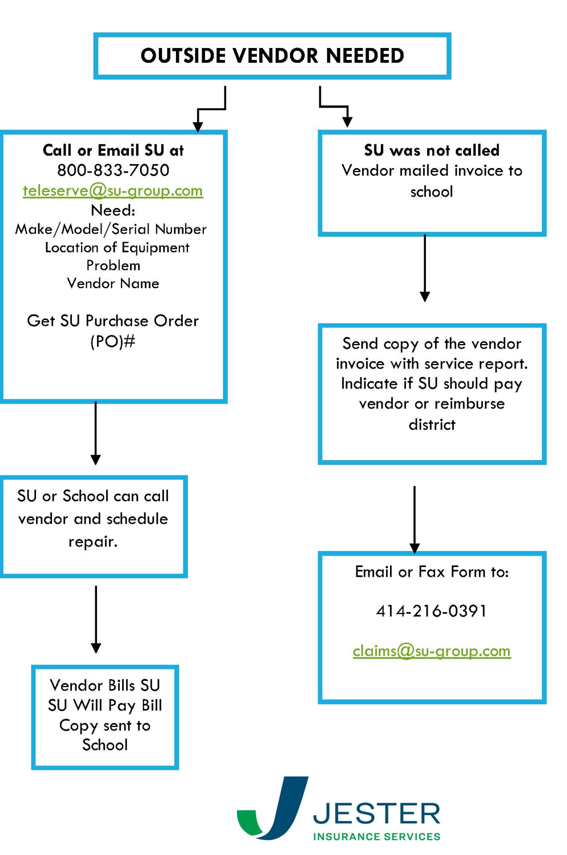
(2) The policy allows the district to be continue using preferred vendors.
If you already have a vendor who performs repairs or preventative maintenance and you want to keep using them, you can.
District decides which process works best for them.

Slide 18
You probably didn’t know…
3. Many districts insure their copiers with Jester/SU.

Slide 19
(3) You might be paying twice for your copiers.
Whether you lease or own your copiers, the policy includes coverage for copier consumables, such as drums, toner and developer (staples and paper are not eligible).
You can continue your current copier vendor relationship, but there is no need pay the vendor for a separate copier maintenance contract since the Equipment Maintenance Insurance Policy offers coverage for these items.

Slide 20
Copier Coverage
(Doesn’t matter if you own or lease)
Location |  | Department
Make/Model |  | Serial No.
Annual # of Copies B&W | Current B&W Meter Reading | Annual # of Color Copies | Current Color Meter Reading
Consumables Included
(i.e.: drums, toner, developer all included)
Staples and paper are not eligible
Provide current copier maintenance agreement/contract for potential first dollar savings

Slide 21
You probably didn’t know…
4. Preventive maintenance is included.

Slide 22
(4) The policy covers preventative maintenance services.
The policy automatically includes Preventative Maintenance per the manufacturer specifications and can be specifically added for HVAC. Risk mitigation/loss prevention tool for insurance companies.
This allows for preventive maintenance of coverage equipment to follow the same claim process as other repairs.

Slide 23
You probably didn’t know…
(5) It’s easier than you think to get started and to participate.

Slide 24
(5) It’s easier than you think.
To get a quote, complete a short application.
No longer need details for all pieces of equipment
Computers – only need to determine quantities by manufacturer and model, and note whether or not they are under warranty (your IT folks probably already have this list). Just do your best.
Specialty Underwriters makes the claim process easy with a flow chart telling you what to provide, an email address for submission of claims, no pre-authorizations unless a repair exceeds $5,000, and 90-days to submit claims
Specialty Underwriters and Jester will also provide training for your staff throughout the policy term

Slide 26
Bonus “Thing” Cash Out Option
“He’s dead Jim”:

Slide 27
What are the school finance implications of participating in an Equipment Maintenance Insurance Program?

Slide 28
School Finance Implications
Because this is an insurance policy, the premium is payable from the district’s Management Fund
One purpose of the Management Fund is to manage risk. The risk that is eliminated from participation is the unanticipated costs of repairs that would otherwise be covered by another fund.
The annual premium insures the equipment covered, and the policy pays the cost if the equipment fails or requires repair.
The district is transferring risk and receiving certainty.

Slide 29
School Finance Implications
Practically speaking, the repairs that would have been attributable another fund (General Fund, PPEL, Sales Tax, Nutrition) are now covered by the insurance policy (Management Fund).
Participation reduces the General Fund expenditures by the amount of the claims by the district (parts and labor).
This means a dollar-for-dollar increase in Spending Authority by the amount of your claims that would otherwise be a General Fund expense.

Slide 30
School Finance Implications
Thought experiment…
For each fund impacted, estimate your annual covered costs less the incremental cost of the insurance.
PPEL Fund
Sales Tax Fund
Nutrition Fund
General Fund
The net General Fund Spending Authority positive impact is the amount attributable to only the General Fund.
However there is a benefit to the other funds as well. For example, fixing stuff rather than buying new benefits your property taxpayers through PPEL or sales tax payers from the State Penny funds.

Slide 31
EQUIPMENT MAINTENANCE PROGRAM EXPERTS
Jester Insurance
Nolan Grimm
515-350-7668
ngrimm@jesterinsurance.com
Melissa Kauffman
515-350-7664
mkauffman@jesterinsurance.com
SU Insurance Company
José McFarland
800-558-9910
jmcfarland@su-group.com
Notes:
Larry: Thanks everyone if you’ve got more questions or want a quote don’t hesitate to reach out to one of the experts at Jester Insurance. We’ve included additional resources at the end of the powerpoint including a FAQ and a series of slides with more detailed coverages listed. And as always if someone at ISFIS can be a resource, don’t hesitate to contact us. Take care3 everyone.

Slide 32
Larry Sigel, ISFIS – Partner
Cell: 515-490-9951
larry@iowaschoolfinance.com
Margaret Buckton , ISFIS – Partner
UEN Executive Director
RSAI Professional Advocate
Cell: 515-201-3755
margaret@iowaschoolfinance.com
We are here to help!
Jen Albers
Office: 515-251-5970 Ext. 4
jen@iowaschoolfinance.com
ISFIS, Inc., 1201 63rd Street, Des Moines, IA, 50311, (515) 251-5970, www.IowaSchoolFinance.com

Slide 33
Coverage Listings
(Contact Jester Insurance for a full listing)

Slide 34
INCLUDED - OFFICE EQUIPMENT
Binder Machines
Bursters
CAD/CAM Systems
Card Readers
Cash Registers
Check Signers
Coin Sorters / Packagers
Currency Counters
Dictation Equipment
Electric Rotary Files
Electronic Typewriters
Embossers
Fax Machines
Folder Machines
ID Card Systems
Laminators
Microfilm Reader / Printers
Microfilmers
Scanners
Shredders
Time & Attendance Systems
Electrical & Electronic Office Equipment (i.e., staplers, hole punchers, typewriters, calculators, etc…)
Electrical & Electronic Print / Press Equipment
UPS / Transient Voltage Protection Systems
Yes, some of these are funny and old fashioned, but the good stuff is coming up…

Slide 35
INCLUDED - CLASSROOM / SHOP EQUIPMENT
Driving Simulators
Electrical & Electronic Auto Shop Equipment
Electrical & Electronic Fitness Equipment
(i.e., treadmills, elliptical, stair climbers, etc…)
Electrical & Electronic Laboratory Equipment
(i.e., microscopes, scales, shakers, etc...)
Electrical & Electronic Sewing Equipment
Electrical & Electronic Shop Equipment
(i.e., testers, meters, etc…)
Electrical & Electronic Wood Shop Equipment
Electronic Audio-Visual Equipment (projectors, flat panel tvs, speakers, microphones, etc)
Electronic Whiteboards
Electronic Band Equipment
(i.e., keyboards, amplifiers, guitars, etc…)
Electronic Photo Shop Equipment
ICN Including Satellite Dishes
Student Response Systems

Slide 36
INCLUDED - COMMUNICATION & SECURITY EQUIPMENT
Communications Equipment:
Audio Visual Systems
Overhead Paging/Intercom/Clock Systems
Radios
Telephone Systems
Telephones, Voicemail System, VOIP
Security Equipment:
Card Access Systems
CCTV Systems
Electronic Gates / Doors
Electronic Library Security System
Fire Alarms
Metal Detectors
Police Alarms
Safes, Chests, Vault Doors

Slide 37
INCLUDED - TECHNOLOGY & MAIL EQUIPMENT
Computer Equipment:
Controllers
Computer Communications
(i.e., modems, switches, routers, wireless access points, etc…)
File Servers
Desktop Computers
Printers
Scanners
Mail Equipment:
Mail Machines / Scales (not system)
Inserters, Labelers, Openers, Stackers

Slide 38
INCLUDED - FACILITIES EQUIPMENT
Auditorium (i.e., stage motors, lighting/audio boards, etc…)
Auto Light Sensors
Building & Grounds (i.e., leaf blowers, weed trimmers, pole saw, power tools, leaf blowers, etc)
Clothes Washers and Dryers
Electrical & Electronic Food Preparation Equipment (ovens, slicers, reach-in coolers, mixers, garbage disposal, ice machines, etc)
Concession Stand Equipment & Vending Machines
Electrical & Electronic Housekeeping Equipment (i.e., vacuum sweepers, floor buffers, etc…)
Electrical & Electronic Pool Equipment/Whirlpool
Electronic Indoor/Outdoor Electronic Scoreboard
Electric Indoor/Outdoor Signs
Kilns
Motors for Bleachers, Basketball Hoops
Pitching Machines (i.e., basketball, volleyball, baseball, softball, etc..)
Water Drinking Fountains (refrigerant & plumbing excluded)

Slide 39
OPTIONAL CATEGORIES
Computer Equipment
Laptops/Chromebooks for Staff and Students
Tablets for Staff and Students
Copiers
Walk-In Coolers/Freezers
Manlifts
Outdoor Building & Grounds Riding Equipment:
Riding Mowers
Riding Field Line Stripers
(no licensed vehicles)

Slide 40
Environmental Control Coverage
(HVAC Coverage)
Coverage is only intended for electronic type equipment and may include:
 Actuators
 Bearings
 Circuit Boards
 Compressors
 Contactors
 Controllers
 Control Center
 Control Panel
 Control & Safety
 Couplers
 Dampers (only electronic components)
 Electrical Disconnect
 Eliminators
 Factory Installed Variable Speed Drives
 Fans (some fans are excluded, see below)
 Flow Switches
 Gauges
 Impellers
 Lubrication Pumps
 Motors
 Positioners
 Pressure Sensors
 Pulleys
 Purge Units
 Relays
 Thermal Expansion Valve
 Thermostats & Sensors
 Valves (electronically controlled)
 Vanes
 Zone Control
Exclusions include, but are not limited to:
Ductwork, Piping, Plumbing, Plumbing Fixtures, Mechanical Valves, Heat Exchangers, Coils, Refrigerant, Refrigerant Leaks, Hazmat Exhaust Fans/Kitchen Hood Type Exhaust Systems, Water Treatment, Chemicals, Chiller and Water Vessels, Boilers, Vessel-Type Equipment, Non-Factory-Installed Components, Crane and Lift Rentals

